Slide 1
Gender-based Discrimination and Labour in Kosovo
Second Edition
By Iliriana Banjska, David JJ Ryan, Endrita Banjska, Nicole Farnsworth, Lirika Demiri, Liridona Sijarina, Adelina Tërshani, Rita Berisha, and Besarta Breznica

Slide 2
Research Aims
Assess the extent of and any changes in awareness related to gender-based discrimination among people and institutions since 2017 (2018-2020) ​
Assess the extent to which institutions are implementing their legal responsibilities related to addressing gender-based discrimination in labour and safeguarding women’s labour rights. ​

Slide 3
Research Questions
To what extent is the legal framework relating to gender-based discrimination complete in accordance with relevant EU directives and protections? ​
How many work-related gender-based discrimination cases have been reported to different institutions in 2008-2020? ​
For what reasons have few discrimination cases been reported?
To what extent are people aware of various forms of discrimination and how to report them; how has this awareness changed over time? ​
How have relevant institutions treated discrimination cases to date; how has this changed over time, if at all?

Slide 4
Methodology: Mixed Methods
Legal analysis​
Desk research​
Survey​
Official requests for gender-disaggregated data​
In-depth interviews with 94 officials from institutions that have a legal responsibility for addressing gender-based discrimination, and with CSO representatives

Slide 5
Methodology: Different Methods
Survey with 5,778 participants (women and men); 681 completed approximately 90% of the survey (75% women, 25% men).​
Limitations: ​
Not generalisable because it did not involve random sampling​
Conclusions thus refer to the sample and not the Kosovo population​
Oversampled educated, urban-dwellers, women​
Hypothesise the situation could be worse for others​
Despite limitations, research provides substantial qualitative evidence of widespread gender-based discrimination.

Slide 6
The Legal Framework

Slide 7
Legal Framework
Constitution (Chapters II and III)
International instruments (Constitution, Art. 22, as amended)
Criminal Code (e.g. Arts. 183 and Chapter XIX)
Legislation:
Law No. 03/L-212 on Labour (“LL”)
Law No. 05/L-021 on Protection from Discrimination (“LPD”), and
Law No. 05/L-020 on Gender Equality (“LGE”)

Slide 8
Overlap in Scope
Law on Labour
Recruitment, promotion, training, terms and conditions of employment, disciplinary measures, cancellation of the employment contract or other matters arising out of employment relationships. (LL, Art. 5.1)
Law on Protection from Discrimination
Access to employment, self employment, promotion, vocational training, working conditions, termination, pay, membership of workers’ organisations. (LPD, Art. 2.1)
Law on Gender Equality
Access to employment, self employment, promotion, vocational training, working conditions, termination, pay, membership of workers’ organisations. (LGE, Art. 15.1)

Slide 9
Overlap in Sanctions
Law on Labour
€100 – €10,000 “for each violation of the provision of ... the prohibition of all forms of discrimination”. (Administrative Instruction No. 07/2012, Art. 7.5.2)
Law on Protection from Discrimination
€1050 – €1,350 for a legal entity. (LPD, Art. 23.2)
Law on Gender Equality
€700 – €900 for a legal entity. (LGE, Art. 23.4)

Slide 10
Good Practices for Harmonisation
“Laws containing provisions relating to the prevention and protection against discrimination shall be harmonized with this Law [on Protection from Discrimination] within two years from the date of entry into force of this Law.” (North Macedonia, LPD No. 258/2020, Art. 48)
“Provisions on minor offences, which are not in accordance with this law, shall be brought into compliance within one (1) year from the day when this law enters into force.” (Law on Minor Offences Nо. 05/L–087, Art. 167)

Slide 11
Labour Rights: Leave
“Kosovo should reform the system of maternity and parental leave, which presents an obstacle to the hiring of women, particularly in the private sector.” (European Commission, 2019)
“Limited access to childcare and flexible working arrangements, as well as regulations which discourage the recruitment of women (e.g. lengthy maternity leave) remain important barriers.” (European Commission, 2021)

Slide 12
Labour Rights: Leave
Increase paternity leave (min. 10 days).
Provide parental leave for all parents (min. 4 months).
Ensure high wage replacement rates to achieve uptake amongst men.
Introduce the right to carers’ leave (min. 5 days).
Develop flexible working arrangements for parents and carers.
(Work-Life Balance Directive, Arts. 4 - 6 and 9)

Slide 13
Labour Rights: Contracts
Measures are required to prevent abuse arising from the use of successive fixed-term employment contracts, e.g.:
Require objective reasons for any fixed-term appointment.
Reduce the time period to become a permanent employee.
Ensure successive contracts are considered cumulatively in calculating qualifying period for labour rights.

Slide 14
Gap between Approximation and Implementation
Implementation
“the … Law on protection from discrimination is broadly in line with European and international standards, but its implementation remains limited.” (European Commission, 2021)
“Kosovo should in particular ... strengthen the implementation of the Law on Gender Equality.” (European Commission, 2021)
“…both rule of law institutions and victims have difficulties in identifying situations in which [the LPD’s] provisions can be applied.” (European Commission, 2019 and 2020)

Slide 15
Implementation
Specialised anti-discrimination training for judges and prosecutors.
Specialised training in a broader context for groups that play a role in protection from discrimination.
Improving data collection procedures.
Ongoing education and public awareness on equal treatment.

Slide 16
Conclusion
Harmonisation of the domestic discrimination legal framework is needed to remove overlap and conflict between instruments.
The EU Work-Life Balance Directive should be transposed to improve the rights of parents and carers.
Amendment is needed to reduce the risk of abuse of successive fixed-term contracts.
A gap between approximation and implementation remains.

Slide 17
Awareness and Reporting of Gender-based Discrimination

Slide 18
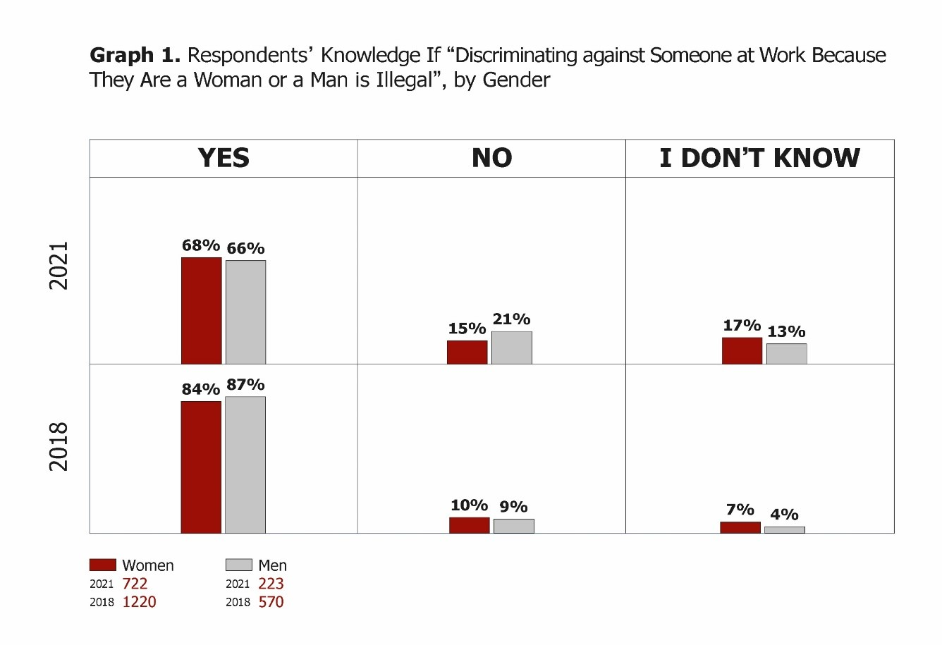
Awareness
Is discriminating against someone at work because they are a woman or a man illegal?

Slide 19
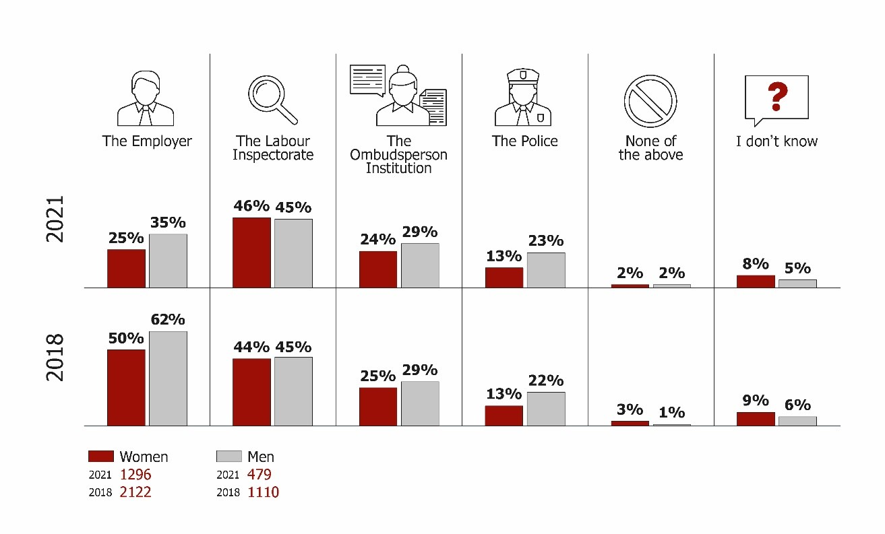
Awareness and Reporting
To which institutions should gender-based discrimination be reported?

Slide 20
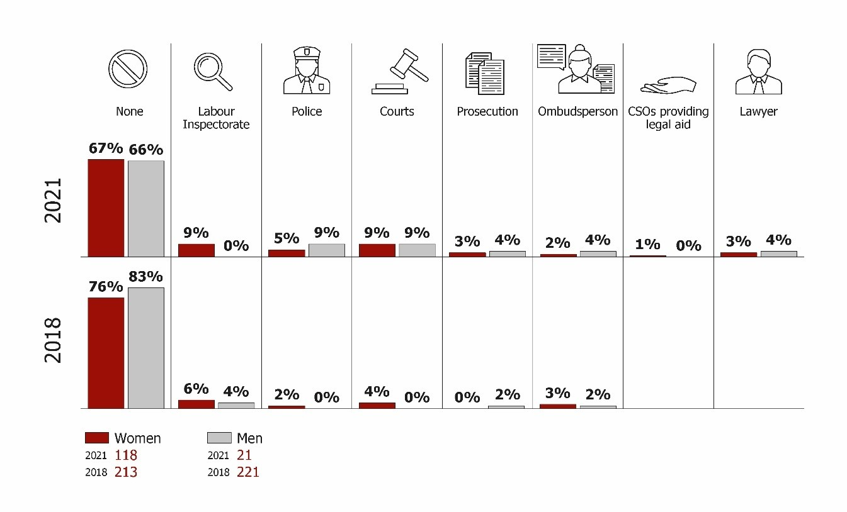
Reporting Gender-based Discrimination
To which institutions did respondents report gender-based discrimination?

Slide 21
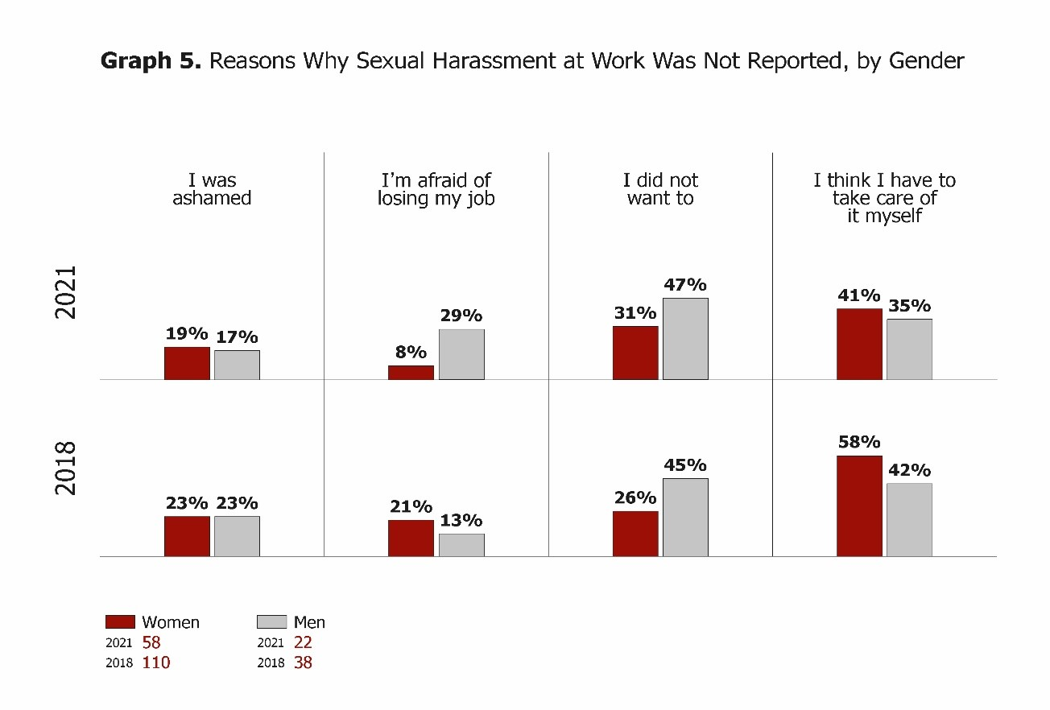
Reporting Gender-based Discrimination
Why didn’t respondents report sexual harassment?

Slide 22
“
“
Discrimination is happening everywhere, but people do not report it. They sacrifice everything for their jobs.
- Woman police officer, Ferizaj/Uroševac, 2018
I have seen several cases when my superior sexually harassed workers. I am aware of all cases, but they are reluctant to tell because they are married, and they are afraid that it will get worse.
- Man, Gjilan/Gnjilane, 2021

Slide 23
Prevalence of Discrimination
In 2018, 28% of surveyed women and 11% of men said they experienced discrimination based on their gender.
In 2021, 23% of women and 12% of men said they experienced this.
Gender remained the strongest predictor for a person to face discrimination: women are two times more likely than men to suffer discrimination.
Discrimination has occurred in both the private sector and in the public administration and government.

Slide 24
Discrimination based on Specific Protected Grounds
“
Gender-based discrimination against persons with different abilities
Very few people with different abilities are employed, particularly women
Against LGBTIQ+ persons
The pandemic was an “opportunity to get rid of the few LGBTQ+ people that were employed”
Against minority ethnic groups
Multiple and intersectional discrimination, especially for Roma, Ashkali and Egyptian women
People are not allowed to talk about their sexual orientation; they are rejected by society. Imagine their position when it comes to employment.
- CSO representative, North Mitrovicë/Mitrovica, 2018

Slide 25
Forms of Gender-based Discrimination

Slide 26
Discrimination in Hiring
“
Approximately one in four surveyed women who attended job interviews believed they were not hired because of their gender.
For men, 16% in 2018 and 21% in 2021
Women faced more questions relating to their marital status, children or related plans
In an interview for a job, I was about six months along in my pregnancy, and they automatically took me off the list of people who they would call in interviews.
- Woman survey respondent, 2021

Slide 27
Discrimination in Promotion
In 2018, 45% of women and 40% of men believed they were not promoted because of their gender.
In 2021, this decreased to 22% of women and 14% of men.
Due to the pandemic, it is difficult to assess whether there was a decrease in discrimination in promotion, or that promotions were less accessible because private companies, public institutions and CSOs were adapting to the new situation.

Slide 28
Violations of Contracts
“
A slightly higher percentage of women (26% in 2018 and 15% in 2021) had worked without contracts than men (22%, 12%)
They told me that women are not capable to do [computer] programming. Me and another colleague [a woman] did not receive any pay. He [the Director] gave us his kids to look after in the software company. He obligated us to do the dishes of the men [that worked in the company] because we are women, and we should keep the space clean.
- Woman survey respondent, 2021

Slide 29
Right to Equal Pay for Equal Work
Agency for Gender Equality: on average men earn approximately €34 net more than women each month.
On average, women earned €312 net, while men earned €346 net a month

Slide 30
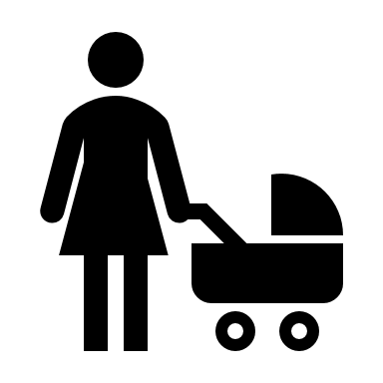
Violations of Pregnancy and Maternity Leave Rights
In 2018, 28% of employed women were pregnant at one point, in 2021, 13% were pregnant while employed in the last three years.
Of them, 26% in 2018 and 14% in 2021 said they were denied their right to paid maternity leave; they were neither paid, nor received government compensation.
Of 245 women who took maternity leave in 2018 , 83% returned to their previous place of employment after their leave; in 2021, 78% of the 58 women who took leave returned to their workplace.
21% of these women in 2018 and 26% in 2021 indicated that they were pressured to return to work earlier than planned.

Slide 31
Violations of Rights to Paternity Leave
Of the new fathers surveyed, 59% in 2018 and 65% in 2021 said that their employer allowed them to take 1-3 days off, while 25% had 4-10 days.
Very few men reported that they were treated differently when returning from leave (only 2% in 2018 and none in 2021)
In the 2018 survey, approximately 11% of new fathers had not received any days off. In 2021, this increased to 19% of employed fathers.
This constitutes a violation of the Labour Law, which foresees at least 2-3 days leave for new fathers.

Slide 32
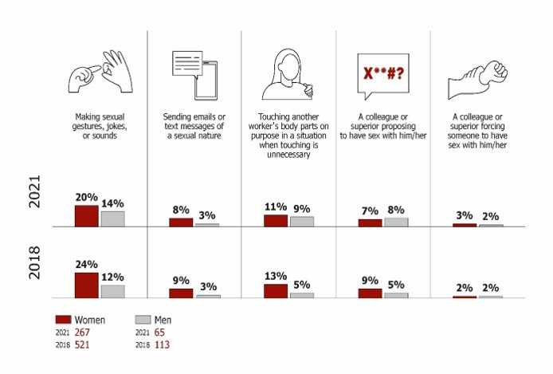
Sexual Harassment at Work
Respondents’ experiences with sexual harassment at work

Slide 33
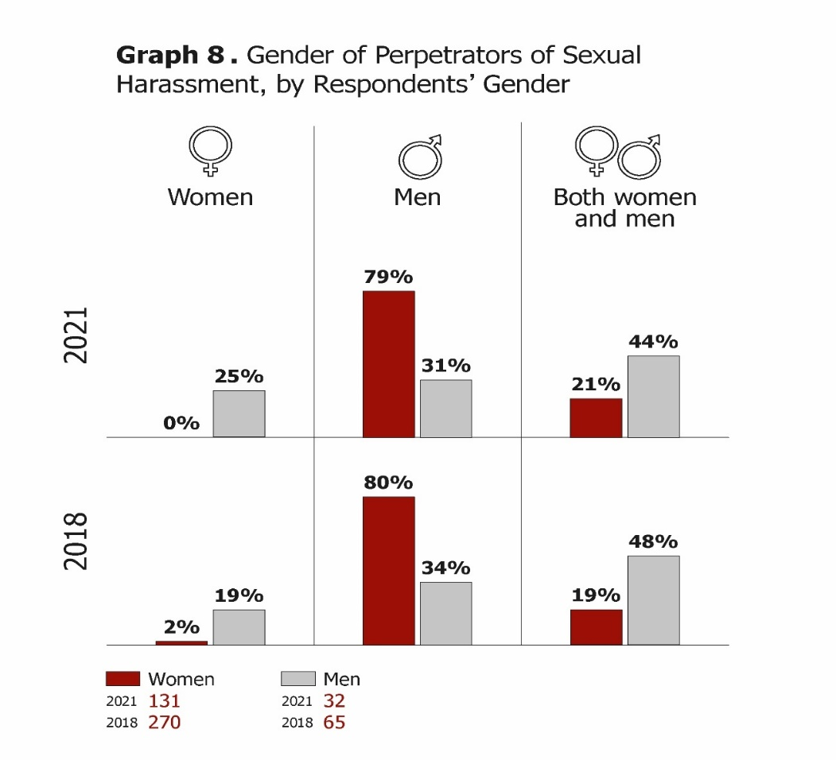
Sexual Harassment at Work
Most survey respondents in 2018 said persons in higher positions harassed them (75% of women, 56% of men).
In 2021, most respondents similarly were harassed by persons in higher positions (72% of women and 61% of men).

Slide 34
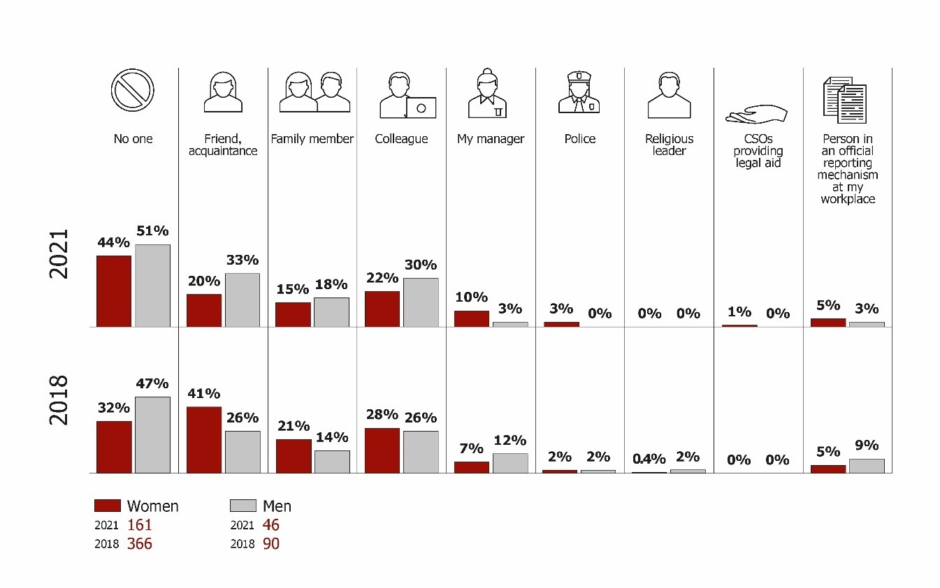
Reporting Sexual Harassment
To whom did respondents report sexual harassment?

Slide 35
Institutional Response

Slide 36
Institutional Response
Police
Ombudsperson Institution
Did not identify sexual harassment as a form of gender-based discrimination
Prosecution & Courts
Few to no cases
Lack practical and detailed knowledge of legal framework
Lack judicial practice
Very knowledgeable
Few cases reported
Slow treatment of cases

Slide 37
Response to Gender-based Discrimination at Work
Labour Inspectorate
Civil Society Organisations
Seem informed on legal framework
Labour Unions
Still few cases reported, though data is inadequate
Recognise their role,
Still few cases
Some inspectors made victim-blaming comments
May not understand what gender-based discrimination entails
Increased awareness on gender-based discrimination and how to refer cases.
Active in asking employees to use their reporting channels
Offered free legal aid and counselling to women.
First responders amid COVID-19 labour rights violations
Monitored cases in courts.
Undertook awareness-raising
Advocated legal amendments and improved implementation

Slide 38
RECOMMENDATIONS

Slide 39
For the Ministry of Finance, Labour and Transfers
Urgently amend and finalize the Law on Labour to align it with the EU Work-Life Balance Directive and to address other shortcomings.
Ensure adequate consultation with civil society
Ensure sufficient budget allocations are made to finance leaves, based on gender analysis and gender-responsive budgeting.

Slide 40
For All Responsible Institutions
Improve data collection and management, ensuring all electronically managed data is disaggregated by:
Gender of victim(s) and alleged perpetrator(s)
Location (e.g., work, home, public space)
Form of discrimination (LGE).
Regularly publish summary data.
Improve inter-institutional awareness-raising and cooperation (e.g., best practice in Albania).
Ensure obligatory, institutionalised training for responsible officials on:
Gender equality and transforming gender norms
Legal framework on gender-based discrimination at work and appropriate referrals
Forms of gender-based discrimination, esp. sexual harassment (Criminal Code definition)

Slide 41
For the Kosovo Police
Improve data management.
Include in obligatory police training information on the legal framework on gender-based discrimination at work, focusing on sexual harassment as a crime, as per the new Criminal Code definition.

Slide 42
For the Prosecution
Update the SMIL database to collect and manage data disaggregated by gender and location.
Ensure all prosecutors undergo training on gender equality and the new Criminal Code definition of sexual harassment.
Consider designating specialised prosecutors, well-trained in prosecuting gender-based crimes.

Slide 43
For the Labour Inspectorate
Improve data management systems: complaints received, inspections undertaken, disciplinary measures initiated, disaggregated by gender and relevant laws breached.
In hiring more inspectors, seek to ensure a gender balance by using affirmative measures, in accordance with the LGE.
Institutionalise regular training for all inspectors on gender equality, gender-based discrimination at work, and their role in treating it.

Slide 44
For the Ombudsperson Institution
Finish revising the OI database, including gender-disaggregated data and marking cases involving gender-based discrimination at work.
Consider ensuring that women representatives of the OI are available to meet women who have suffered gender-based discrimination.
Ensure all OI offices have confidential spaces available for OI representatives to meet women and other actors.
In close cooperation with CSOs, the Labour Inspectorate and labour unions, organise regular awareness-raising campaigns on gender-based discrimination towards increasing citizens’ knowledge of what it entails, how they can file claims, and what support the OI can provide.

Slide 45
For Labour Unions
Collect data on gender-based discrimination cases by gender and violation.
Ensure policies against gender-based discrimination and equal opportunities are in place and implemented.
Provide further training for all union representatives on the relevant legal framework on gender-based discrimination at work and how to report it.
Launch outreach campaigns to inform workers about the legal framework on gender-based discrimination and labour. Continue collaborating with experienced WCSOs for more effective outreach, targeting women.
Improve people’s awareness and trust in unions, including how unions can support persons who have experienced gender-based discrimination at work.
Improve women’s participation in unions.
Monitor the work of the Labour Inspectorate to verify if gender-based discrimination at work is being addressed correctly.

Slide 46
For Civil Society Organizations
Continue collaborating through a diverse network of CSOs involved in anti-discrimination activities, including joint advocacy for needed legal changes and their implementation.
Continue organising awareness-raising campaigns to increase women’s and men’s knowledge about gender-based discrimination in labour and where to report it.
Specifically target people from minority ethnic groups, LGBTIQ+ persons and persons with different abilities with information about their rights; support them in reporting and seeking justice for gender-based discrimination.

Slide 47
For the European Union
Continue to encourage the government to expedite legal amendments and reforms in line with the EU Work-Life Directive and to implement the legal framework on gender-based discrimination through:
Kosovo Report (Ch. 19)
Political Dialogue
Cooperation programming (continue to ask contractors to further gender equality in their support of reforms)
Continued cooperation, support, and dialogue with WCSOs.

Slide 48
Co-funded by Sweden/Sida

Slide 49
Gender-based Discrimination and Labour in Kosovo
Second Edition
By Iliriana Banjska, David JJ Ryan, Endrita Banjska, Nicole Farnsworth, Lirika Demiri, Liridona Sijarina, Adelina Tërshani, Rita Berisha, and Besarta Breznica

