Slide 1
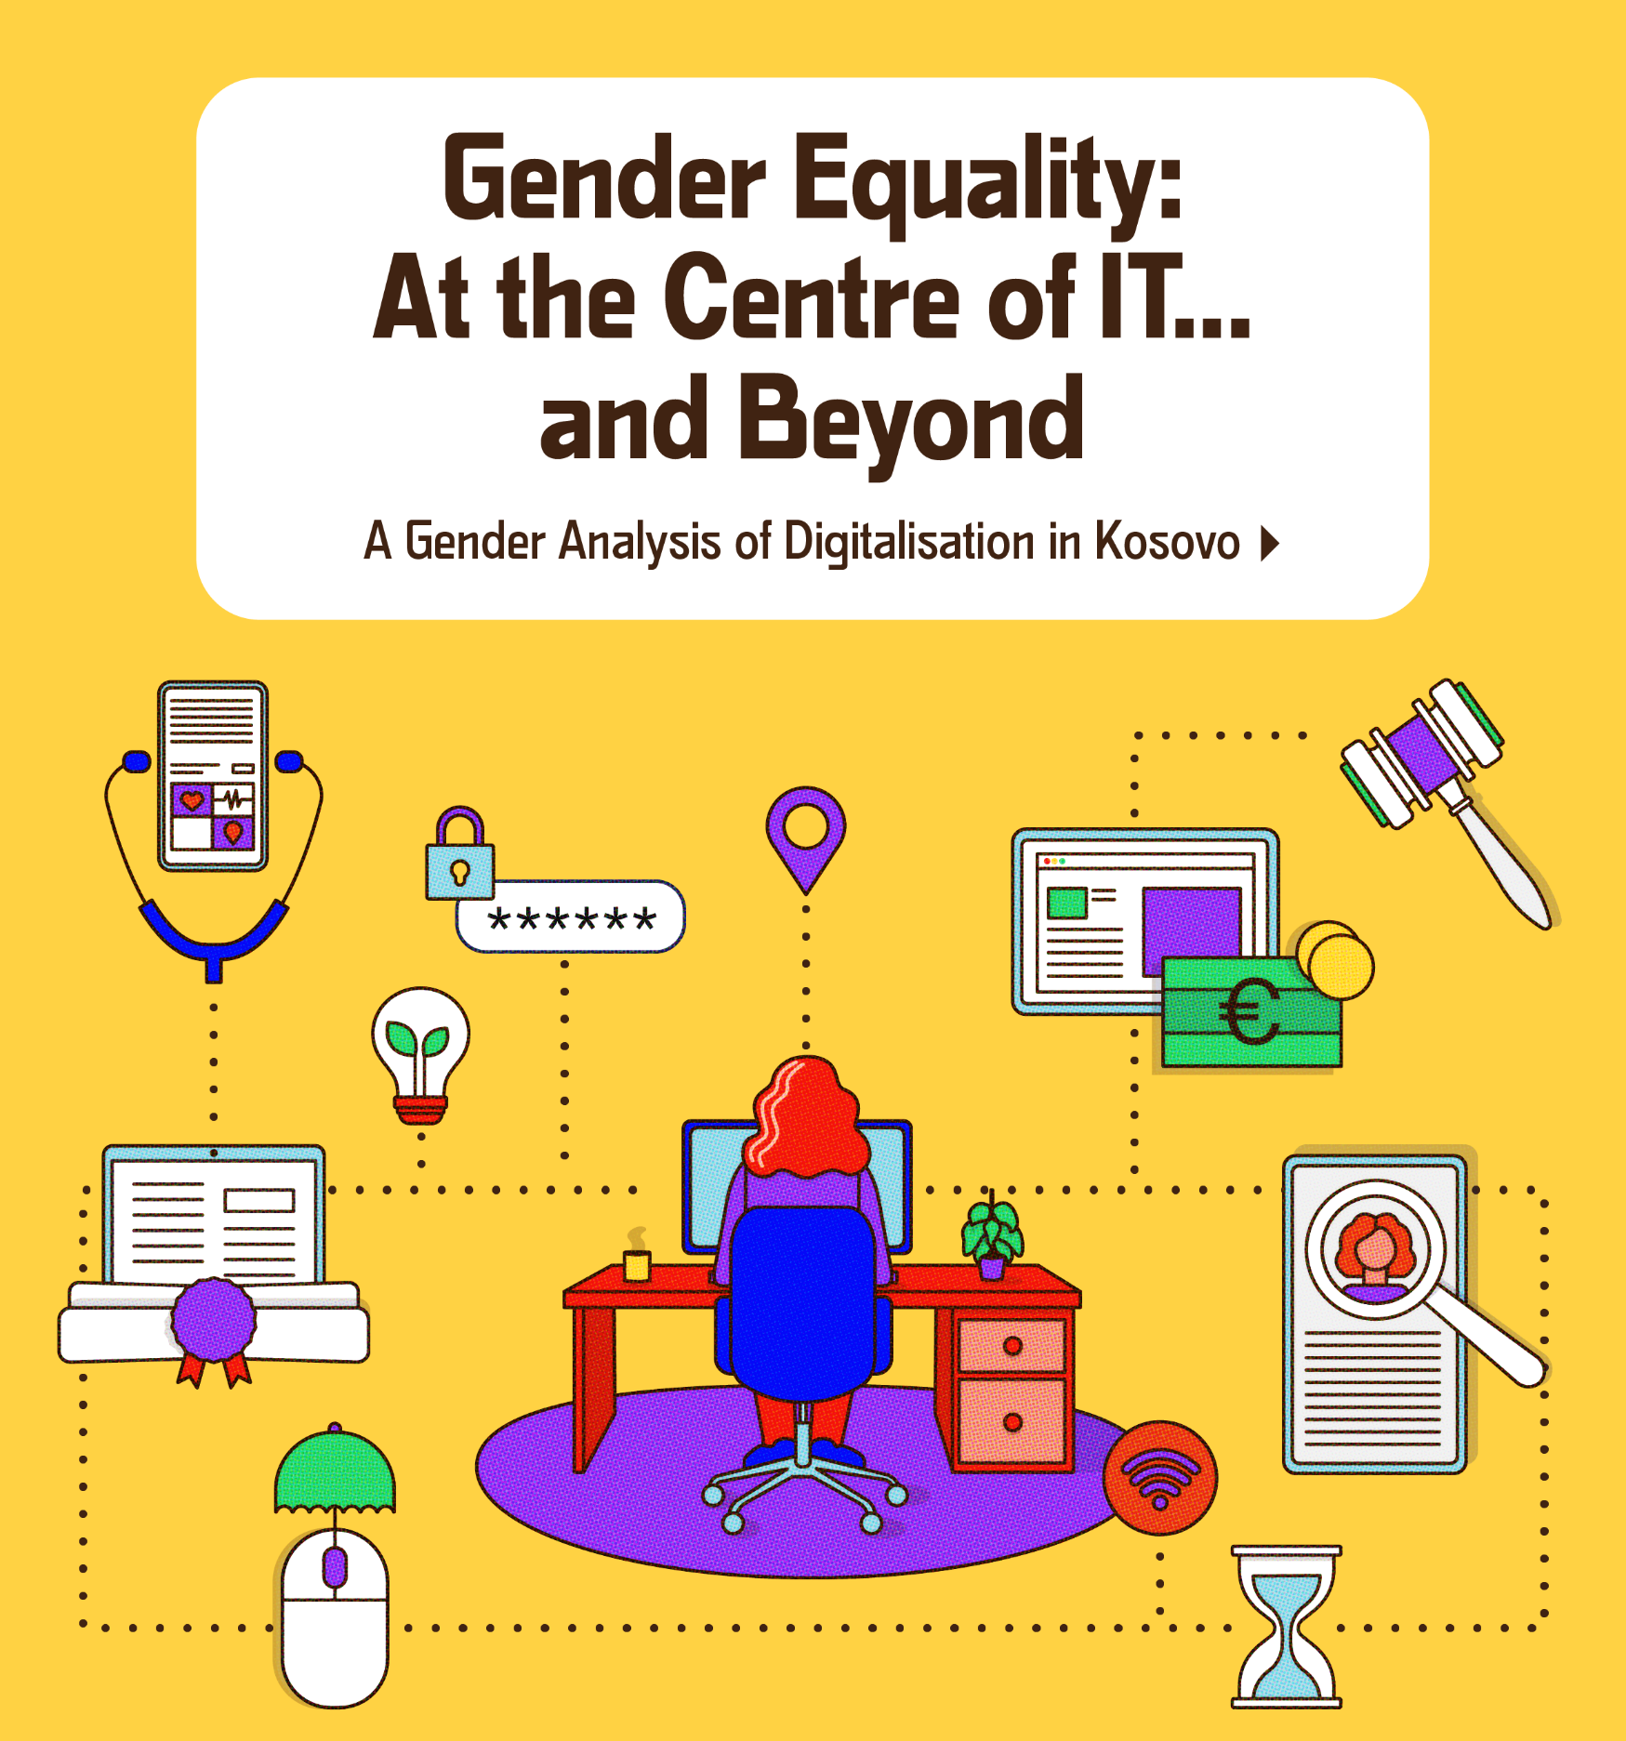

Slide 2
Aims
Support Government Gender Equality Impact Assessments, towards gender-responsive reforms related to digitalisation.
Support the EU with data and recommendations that can inform political dialogues and IPA III programming.
Provide civil society with evidence for advocacy.
Create new conceptual framework for gender analysis of digitalisation.

Slide 3
Methodology

Slide 4
Research Questions
To what extent are Kosovo’s laws, policies, and strategies related to digitalisation gender-responsive?
To what extent have diverse women and men had equal access to digitalisation?

Slide 5
Conceptual Framework: UNDP’s Inclusive Digital Transformation Framework

Slide 6
KWN’s Gender-responsive Adaptation of UNDP’s Inclusive Digital Transformation Model

Slide 8
Gender Analysis Framework

Slide 9
Research Methods
Desk review
Data analysis
Semi-structured interviews (26 women, 20 men)
Content, textual, and image analysis

Slide 10
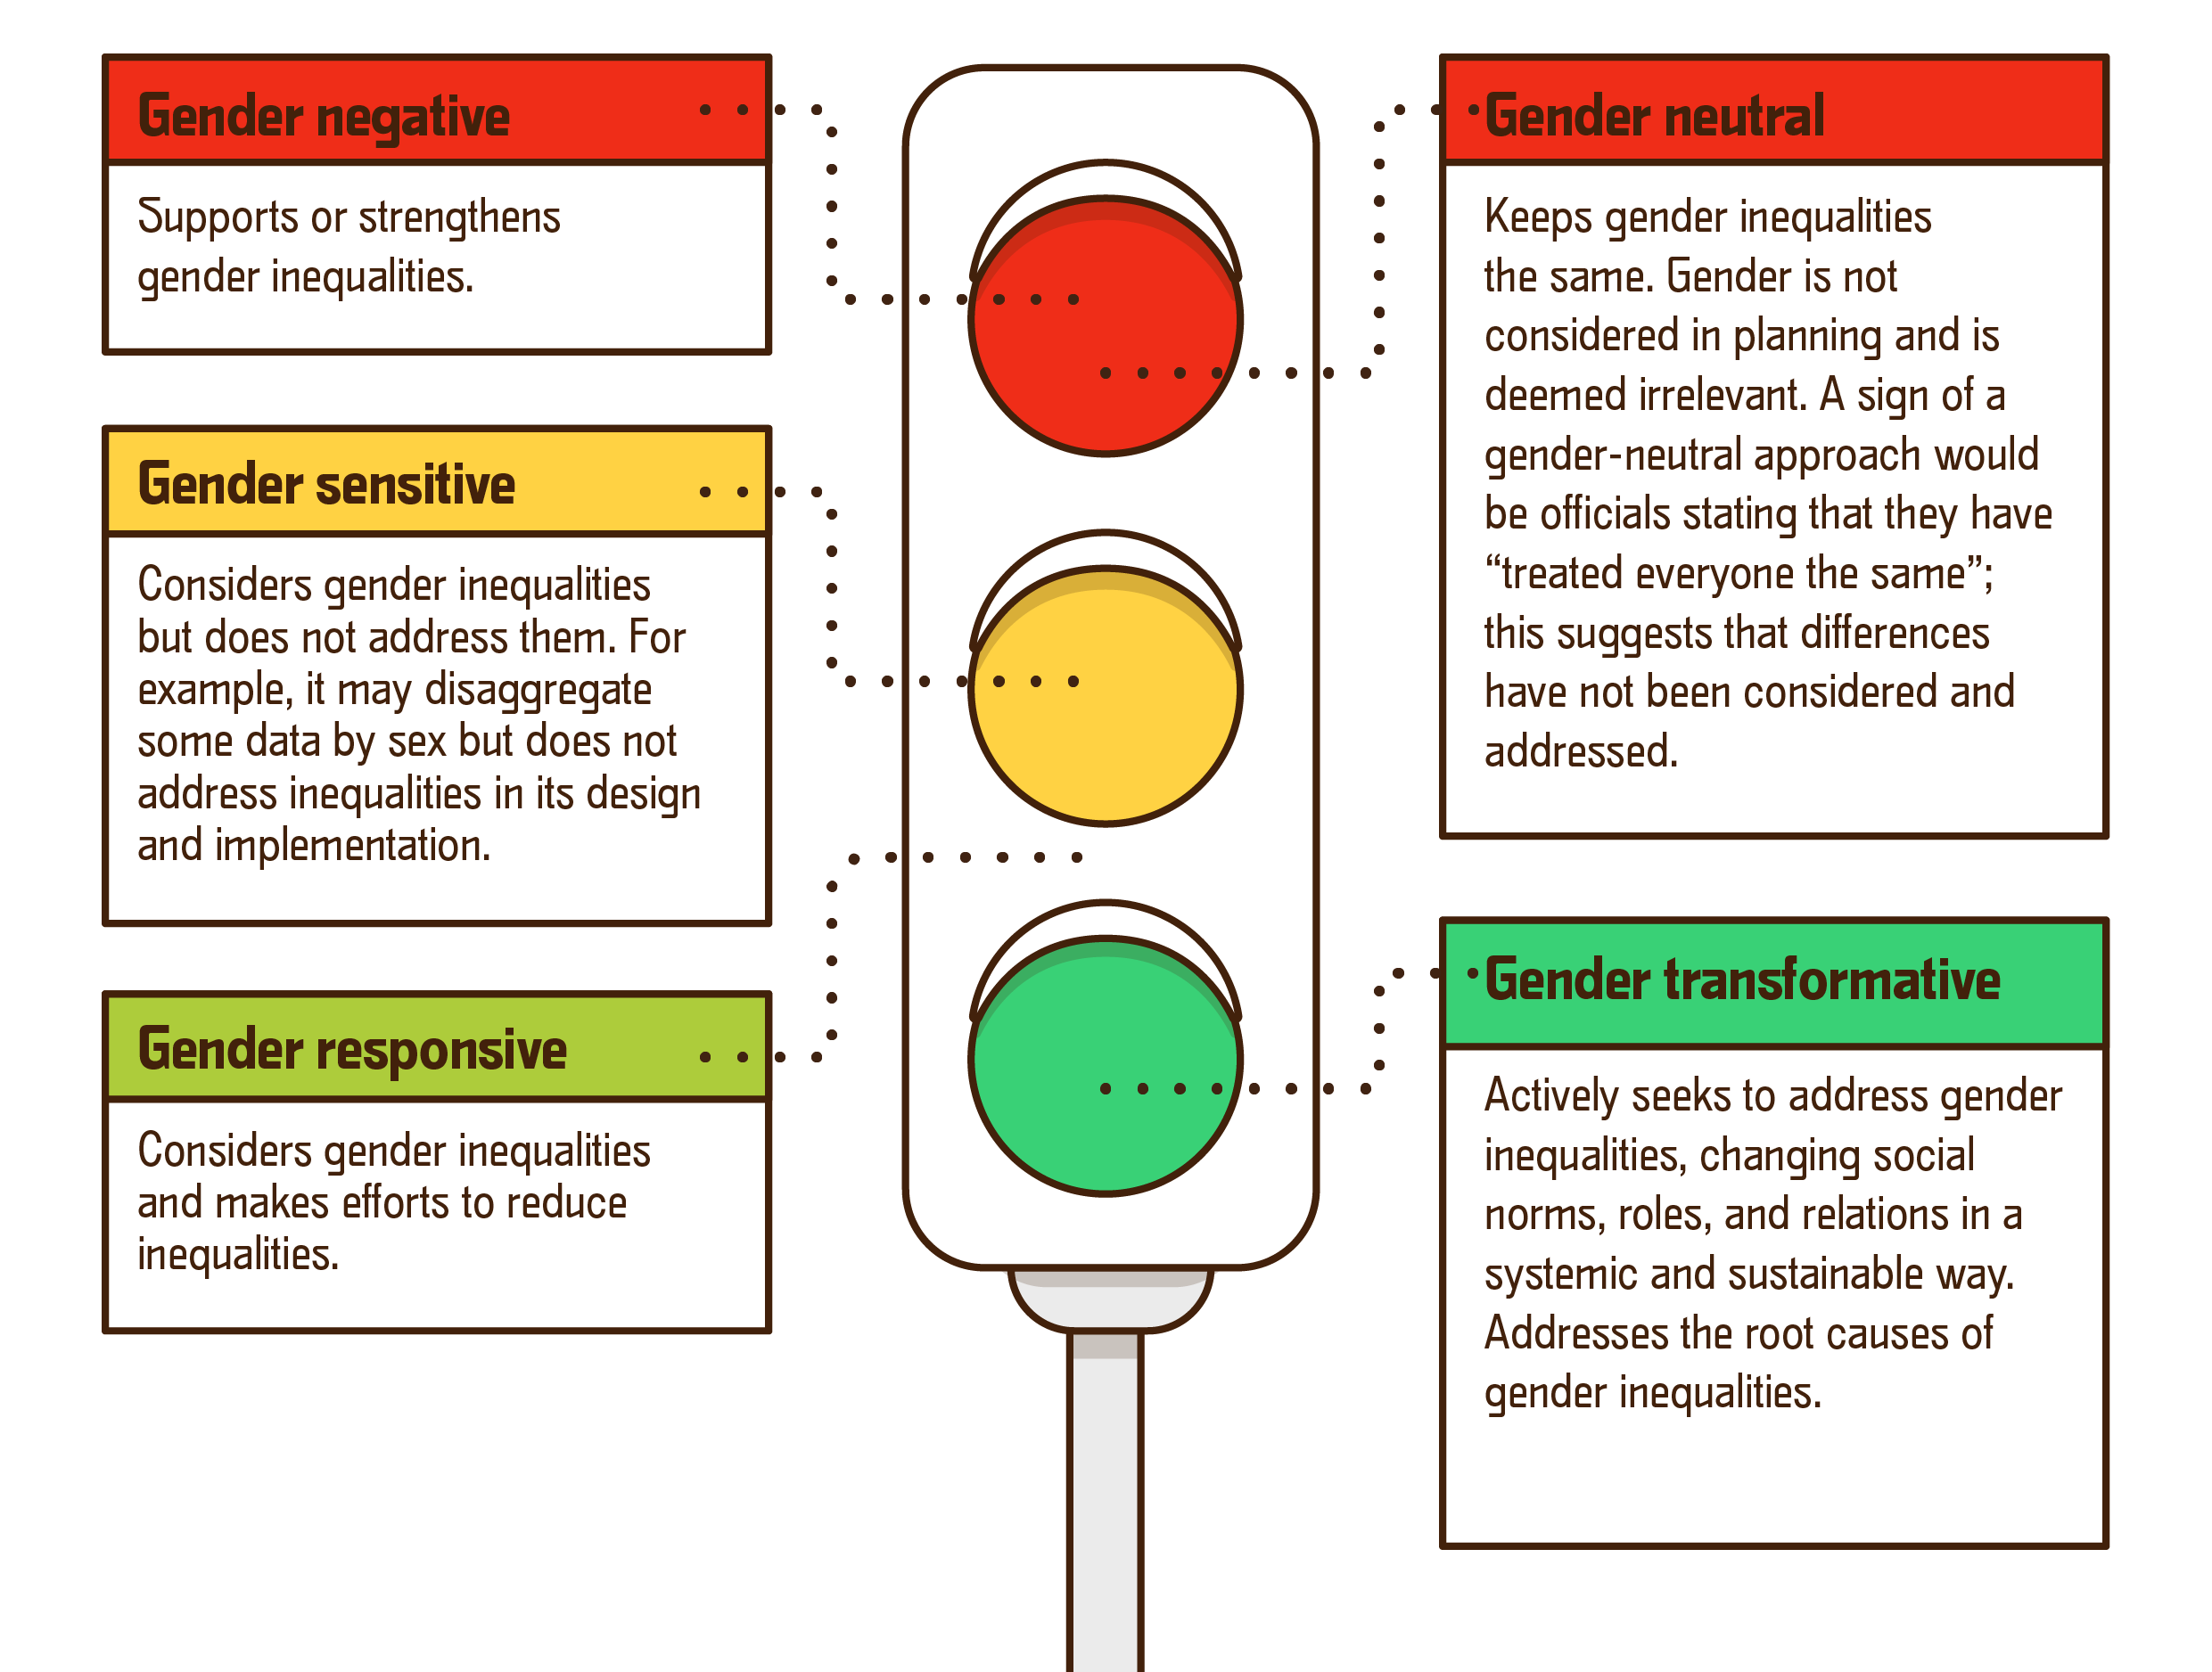
Gender Analysis: Traffic Lights Scale of Gender-transformativeness

Slide 11
Limitations & Validity
Minimal data
Weak research participant understanding of digitalisation, gender, interrelationships
Government and legal changes required revisions (as of mid-Dec. 2023)
Challenges related to the COVID-19 pandemic
Time constraints
Validity: triangulation of methods, data sources, and researchers; participant checks

Slide 12
What’s inside? Several sectors…
1. Digitalisation
Assembly, Government, public administration
2. Rule of law
3. Social services
4. Education
5. Employment
6. Business and trade
7. Agriculture
8. Climate change, energy
9. Health
10. Media and communications

Slide 13
Inside Each Chapter: KWN’s Gender-responsive Inclusive Digital Transformation Model
Gender analysis of Regulation (legal and policy framework)
Governance
Infrastructure
People
Business
Recommendations

Slide 14
Findings

Slide 15
Persistent Stereotypes and Prejudices
“Women and girls have opportunities equal to men’s to participate in innovation.”
“Women are perceived as more frivolous and inquisitive, and therefore are more susceptible to online abuse.”
“Digital transformation is neutral; our efforts directly benefit girls and women equally.”

Slide 16
Regulation
Public policies related to digitalisation are not gender-mainstreamed. Laws, regulations, strategies are gender-neutral.
They lack gender analysis, gender impact assessments and ex-post gender analysis.
They do not have monitoring reports and are carried out without sufficient institutional coordination.

Slide 17
Governance
Officers responsible for digitalisation reforms lack awareness about the importance of gender mainstreaming, while gender equality officers lack expertise in digitalisation.
Digital public services are minimal and do not attend to gender, age or ethnicity.
Gender-disaggregated data related to users of institutions’ e-systems are inadequate or entirely unavailable. Tracking such data is often deemed unnecessary.

Slide 18
Infrastructure
Government software and platforms lack the capability to gather, publish or update gender-disaggregated data.
Platforms thus do not provide public services tailored to the needs of women and men.
Connectivity infrastructure and digital tools, such as smartphones, are widely available.
Nevertheless, constraints exist in utilising this infrastructure to access services, contigent on age, gender and geographical location.
Notes:
Mbledhja e pamjaftueshme e të dhënave të ndara sipas gjinisë pengon aftësinë e institucioneve për të përdorur të dhënat për të informuar reformat sociale, të punësimit, apo edukimit.

Slide 19
People in Digitalisation
While women and men generally have access to digital devices, Roma, Ashkali, Egyptians, and vulnerable groups encounter challenges in affording these devices.
Women and men tend to use digital devices primarily for social purposes; however, men use them more than women for business endeavors and networking.
Neither women or men use of public online services, and women engage even less due to gender norms; men register in institutions as heads of households.

Slide 20
Both women and men lack digital literacy skills, including related to digital wellbeing.
Persons with disabilities are most susceptible to digital exclusion (32% of women, 35% of men), followed by low-income households (29% of women and men).
Women from rural areas are disproportionately disadvanted in terms of access to technology and information.

Slide 21
Women and girls encounter subtantial barriers in keeping pace with the digital transformation, due to:
Insufficient time to develop digital skills
Limited access to financial resources or new technologies
Limited political power and participation in decision-making
Inadequate protection in the legal framework
Unequal care responsibilities, frequently preventing women from accessing professional ecosystems where they could develop their personal or professional digital skills

Slide 22
Sectors: Gender-responsive Digitalisation in…
Social Services
Rule of Law
Governance, Public Administration
Education
Media
Notes:
Explain ëhy these three – to offer findings and food for thought on panel discussions;

Slide 23
Gender Analysis of Digitalisation and Governance
Government: The Prime Minister's Office leads digitalisation efforts. As a result, reforms are centralised and often subject to delays. Municipalities rely solely on the Agency for Information Society for electronic communication.
92% of institutions’ IT staff are men. Affirmative measures are not being implemented as per the Law on Gender Equality.
The Agency for Gender Equality and Gender Equality Officers were not consulted during policy-making processes related to digital reforms.
Kosovo Agency for Statistics: insufficient staff capacity in gender-responsive data management, delays in publishing data, and poor inter-institutional coordination.

Slide 24
In 2021 the Agency for Information and Privacy began on-site inspections. Insufficient human resources is a challenge in identifying and addressing privacy threats, including those that are gender-based.
Agency for Information Society: The lack of a gender perspective in AIS and relevant institutions, which delegate digitalising public services to AIS, has led to an e-platform that is gender-neutral.
Despite not utilising e-Kosova to conduct periodic gender impact analyses, AIS officials were willing to initiate this practice. They lacked the necessary gender expertise to do so.

Slide 25
eKosova Platform Users by Gender
Property tax (29.7% men and 10.9% women)
Vehicle registration (15.3% men and 5.1% women)
Police, fines, criminal history (24.9% men and 2.3% women)
Property (7.1% men and 0.6% women)
Pension contributions (13.5% men and 9.0% women)
Judiciary (5.4% men and 3.4% women)

Slide 26
Gender Analysis: Digitalising Rule of Law
Notes:
Kapitulli kyc;
Mbrojtja, aspekti rregullativ – duhet te reflektojne reformat digjitale.

Slide 27
The legal framework addressing the risks associated with digitalisation is predominantly gender-neutral:
Criminal Code
Criminal Procedure Code
Law on Protection from Domestic Violence and Gender-based Violence
Law on the Prevention of Cyber-violence
Kosovo Security Strategy, etc.
The legal framework is unclear regarding inter-agency coordination to combat gender-based cyberviolence and cybercrime.
The 2023 Law on Prevention and Protection from Domestic Violence, Violence against Women, and Gender-based Violence outlines the duties of the Inter-ministerial Coordinating Group. It does not explicitly mention responsibilities related to gender-based cyberviolence and cybercrime.

Slide 28
The lack of clear definitions results in subjective interpretations among police officers regarding cybercrime.
The absence of regulations on gender-based cyberviolence contributes to confusion regarding relevant authorities’ responsibilities in resolving cases.
Similar to victim-blaming in cases of gender-based violence, police officers also tended to blame women for the violence they suffered online.

Slide 29
Key institutions such as the police, prosecution, and courts still face challenges in promptly distributing gender-disaggregated data. The Ministry of Justice database on gender-based violence is not interoperable with the Electronic Case Management System.
Courts reported a low level of involvement in handling cybercrime cases. Among the cases they addressed, they did not maintain gender-disaggregated data.
Kosovo still lacks infrastructure for implementing the Law on Electronic Surveillance, which can contribute to gender-based violence.

Slide 30
Men tend to be perpetrators of cybercrimes, including gender-based violence, while women, children, and LGBTIQ+ persons are more prone to being victims of such crimes due to power dynamics and gender norms.
Women, especially, hesitate to report cybercrimes due to a lack of trust in institutions and the fear that their reporting may be made public, potentially jeopardizing their safety, as well as family and social relationships.

Slide 31
Gender Analysis: Digitalising Social Services

Slide 32
Shifts in government responsibilities regarding social services have impacted the advancement of both social and digital reforms.
The Government’s restructuring of social services and assistance has created confusion among citizens regarding which government entity is responsible for each service.
Such changes occurred without public consultation with experts and civil society. The Government has not communicated these changes clearly to the public, using electronic platforms.

Slide 33
There is a lack of data coordination among the Kosovo Agency of Statistics, MFLT, the Division of Social Services and Centres for Social Work.
Poor electronic data diminishes their capacities to enable more gender-responsive monitoring, evaluation, and design of social assistance services. This includes assessing the real-time needs of both women and men concerning these services.
Notes:
Në kuadër të Ministrisë së Financave, Punës dhe Transfereve (MFPT-së), Divizioni i Shërbimeve Sociale (DSS) propozon, zhvillon dhe monitoron zbatimin e legjislacionit, standardeve dhe procedurave të shërbimeve sociale. DSS nuk ka realizuar vlerësime të ndikimit gjinor për të informuar vlerësimin e ndihmës sociale ose shërbimeve sociale.

Slide 34
Officials’ skills in utilising digital alternatives for service provision is inadequate, as they lack the fundamental infrastructure required.
Social workers at CSWs often lack technical skills to enter beneficiaries’ data into the Social Assistance Scheme (SAS) system.
Social workers breach the principle of data protection; these cases remain unaddressed or go unreported entirely.
Social workers lack skills and knowledge regarding the potential impact digital technologies may have on children or other vulnerable groups they serve.
No known assessment has been conducted to evaluate the capacities of social workers in safeguarding girls and boys from potential online abuse, or their gender sensitivity concerning technological influences.

Slide 35
Gender Analysis: Digitalising Education

Slide 36
MESTI holds primary responsibility for coordinating digitalisation-related reforms in the education sector. Coordination among pre-university education institutions at central and municipal levels toward digital reforms is hindered by insufficient human capacities, frequent staff turnover, centralised digitalisation efforts, and political influence.
MESTI has a Division of Science and Technology, but it remains unclear whether it holds responsibility for digitalization in the sector. KWN has not found evidence indicating the existence of relevant divisions for digitalisation within MED, schools, etc., which often have a political role distinct from that of IT specialists responsible for maintaining technological equipment.
MESTI has implemented several affirmative measures towards transformative gender education and digitalisation, such as scholarships for girls attending vocational schools in technical fields where they have been underrepresented, including in IT.

Slide 37
There is insufficient gender-responsiveness in reforms for protecting boys and girls from electronic communications in the education system. Regulations, protocols, and manuals regarding children’s internet protection overlook the diverse challenges boys and girls face online due to their gender or sexuality.
KWN observed that incidents of cyberbullying and harassment targeting girls in schools are widespread.
MESTI has initiated reforms in VET to align skills with labour market demands. There are concerns that VET schools lack specialisation in profiles that meet labour market needs, particularly in IT fields, leading to inadequate student support.
Occupational segregation in fields of study persists: girls typically pursue studies in health and wellness, business, administration, and law, whereas boys tend to focus on engineering, manufacturing, construction, and ICT.

Slide 38
Gender Analysis: Digitalising Media

Slide 39
Electronic communication options have positioned women and LGBTIQ+ persons at the forefront of negative portrayals, smear campaigns, virtual threats, and cyberbullying.
Reports sensationalising violence and media headlines serve as primary sources of hate speech against women, particularly in cases of sexual violence, where sexist, derogatory, and discriminatory discourse is aimed at women, especially young women.
Notes:
Fushatat e shpifjeve kundër grave i synojnë ato bazuar në gjininë e tyre dhe përfshijnë stereotipe të socializuara gjinore në lidhje me "rolet", veshjen dhe llojet e trupit të grave të pranueshme nga shoqëria. Një theks i tillë mediatik ul efektivitetin e tyre, përforcon stereotipet gjinore dhe potencialisht i dekurajon gratë e tjera nga përfshirja në politikë.

Slide 41
KWN found no evidence of an institutional mechanism in place to punish and monitor online violence and hate speech.
Feminist activists and LGBTIQ+ activists stated that they seldom reported threats to the police due to a lack of trust that such cases would be resolved.
Cyberviolence has frequently compelled activists to withdraw from the public sphere and deactivate social networking accounts. Cyberviolence is diminishing the available public space for women and queer activists.

Slide 42
Several Additional Findings in Other Sectors

Slide 43
Recommendations

Slide 44
Ensure civil society engagement, especially CSOs with relevant expertise, in the drafting of public policies and reforms related to digitalisation by including them in official working groups, public hearings and via the public consultation platform.
Collect, record, analyse and use gender-disaggregated data from all institutions to ensure that the design of public digital applications, platforms and services is informed by the needs of women and men. Create accountability and inspection mechanisms for keeping and updating data.

Slide 45
Cooperate to design and implement awareness campaigns aimed at different women and men with information about:
Forms of cybercrime, cyberviolence and how to report them
Digital services available
Digital well-being, security and privacy
Possibilities for using digital tools beyond social media.

Slide 46
In consultation with AGE, use affirmative measures in employment, especially in IT fields, throughout the Government and public administration, as per the Law on Gender Equality.
Clarify and coordinate the exchange of electronic data between all institutions (disaggregated by gender, ethnicity, age, rural/urban location and disability), enabling evidence-based policymaking.
Ministry of Internal Affairs: Establish the infrastructure for electronic surveillance, implementing the Law on Electronic Surveillance. This will contribute to protecting women who have experienced gender-based violence.

Slide 47
Kosovo Police: Define the responsibilities of KP units in treating gender-based cyberviolence, eliminating subjective interpretations of what constitutes cybercrime and confusion in responsibilities. Employ affirmative actions to recruit more women into the KP Cyber Crimes Investigation Unit.
AIS: Transmit, monitor and publish gender-disaggregated data related to the eKosova platform; use it to digitalise more services that respond to the needs of women and girls (e.g., applications for social housing, social assistance).

Slide 48
MJ: Të përcaktohet dhe rregullohet qartë krimi kibernetik në Kodin Penal nga perspektiva gjinore, duke përfshirë lloje të ndryshme të krimit kibernetik si dhuna seksuale e bazuar në imazhe, ngacmimet seksuale në internet, ngacmimet kibernetike dhe shantazh seksual (sextortion), “hakmarrja” pornografike.
Të sigurohen trajnime të detyrueshme për një qasje të përgjegjshme gjinore për trajtimin e krimit kibernetik dhe dhunës kibernetike si pjesë e trajnimit bazë për të gjithë zyrtarët e PK-së.

Slide 49
Ministry of Finance, Labour, and Transfers (Department of Social Assistance): Provide accurate gender-disaggregated data, before any social reform, identifying how proposed social schemes will benefit diverse women and men; avoid potential data biases from AI, and balance AI with face-to-face evaluations.
Ministry of Economy: Conduct an ex-post gender impact assessment to analyse the impact of KODE on different women and men, including tracking long-term post-placement employment by gender and other demographic indicators.
IMC: Monitor and sanction media that broadcast content that cultivates gender-based violence, gender roles and stereotypes.

Slide 50
Donors: Continue funding CSOs to compile intersectional gender analyses to support the Government with expertise, informing the integration of a gender perspective in laws, policies, programs and budgets towards digital reforms.
(W)CSOs: Use public consultation mechanisms and continue monitoring the implementation of public policies related to digital reforms, towards ensuring their inclusiveness.

